Slide 1
Threads

Slide 2
Threads
A thread is a flow of execution through the process code with its own program counter that keeps track of which instruction to execute next, system registers which holds its current working variables and a stack which contains the execution history.
Thread is also called lightweight process.
Threads provide a way to improve application performance through parallelism.

Slide 3
Threads
Each thread belongs to exactly one process and no thread can exist outside a process.
Each Thread represents separate flow of control.

Slide 4
Process Characteristics
Unit of resource ownership - process is allocated:
  a virtual address space to hold the process image
  control of some resources (files, I/O devices...)
Unit of dispatching - process is an execution path through one or more programs
  execution may be interleaved with other process
  the process has an execution state and a dispatching priority

Slide 5
Process Characteristics
These two characteristics are treated independently by some recent OS
The unit of dispatching is usually referred to a thread or a lightweight process
The unit of resource ownership is usually referred to as a process or task

Slide 6
Threads vs. Processes
A thread has no data segment or heap
Thread is lightweight, taking lesser resources.
A thread cannot live on its own, it must live within a process
Inexpensive creation
Inexpensive context switching, does not need to interact with operating system.
If a thread dies, its stack is reclaimed.
Multiple threaded processes use fewer resources.
A process has code/data/heap & other segments.
Process is heavyweight or resource intensive.
There must be at least one thread in a process
Expensive creation
Expensive context switching, needs interaction with operating system.
If a process dies, its resources are reclaimed & all threads die.
Multiple process without using threads use more resources.

Slide 7
Threads
Thread minimize the context switching time.
Use of threads provides concurrency within a process.
Efficient communication.
It is more economical to create and context switch threads.
Threads allow utilization of multiprocessor architecture to a greater scale and efficiency.

Slide 8
Multithreading vs. Single threading
Multithreading: when the OS supports multiple threads of execution within a single process
Single threading: when the OS does not recognize the concept of thread
MS-DOS support a single user process and a single thread
UNIX supports multiple user processes but only supports one thread per process
Solaris supports multiple threads

Slide 9
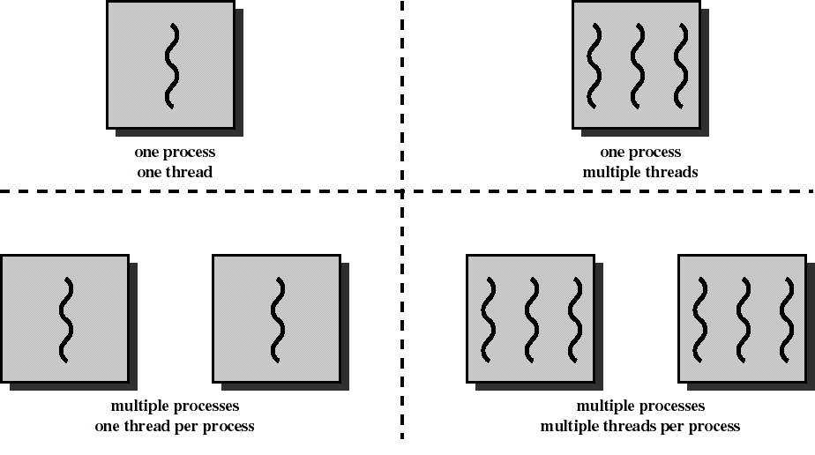
Threads and Processes

Slide 10
Processes
Have a virtual address space which holds the process image
Protected access to processors, other processes, files, and I/O resources

Slide 11
Threads
Has an execution state (running, ready, etc.)
Saves thread context when not running
Has an execution stack and some per-thread static storage for local variables
Has access to the memory address space and resources of its process
  all threads of a process share this
  when one thread alters a (non-private) memory item, all other threads (of the process) sees that
  a file open with one thread, is available to others

Slide 12
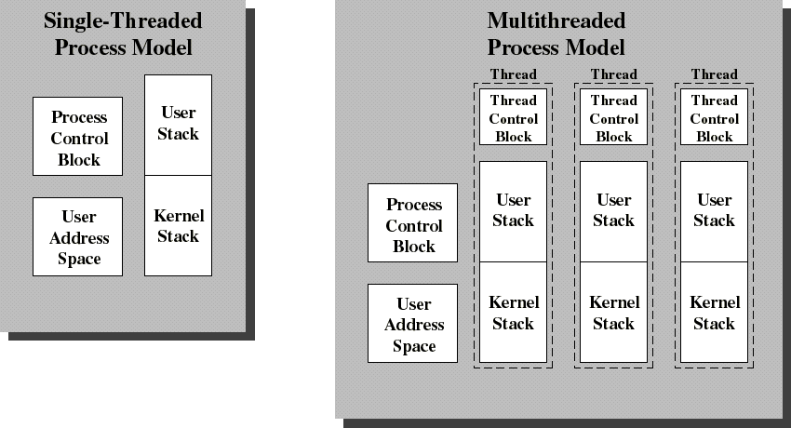
Single Threaded and Multithreaded Process Models
Thread Control Block contains a register image, thread priority and
thread state information

Slide 13
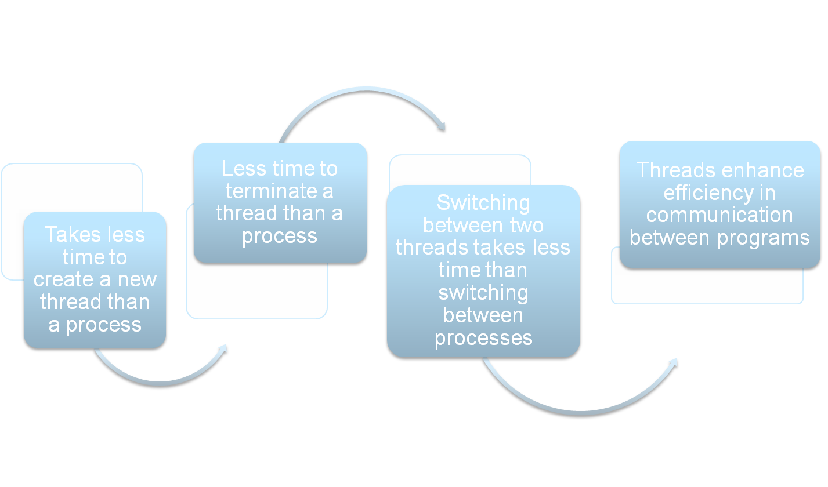
Benefits of Threads
Notes:
Thus, all of the threads of a process share the state and resources of that process. They reside in the same address space and have access to the same data. When one thread alters an item of data in memory, other threads see the results if and when they access that item. If one thread opens a file with read privileges, other threads in the same process can also read from that file.
The key benefits of threads derive from the performance implications:
1. It takes far less time to create a new thread in an existing process than to
create a brand-new process. Studies done by the Mach developers show that
thread creation is ten times faster than process creation in UNIX [TEVA87].
2. It takes less time to terminate a thread than a process.
3. It takes less time to switch between two threads within the same process than to switch between processes.
4. Threads enhance efficiency in communication between different executing programs. In most operating systems, communication between independent processes requires the intervention of the kernel to provide protection and the mechanisms needed for communication. However, because threads within the same process share memory and files, they can communicate with each other without invoking the kernel.
Thus, if there is an application or function that should be implemented as a set of related units of execution, it is far more efficient to do so as a collection of threads rather than a collection of separate processes.

Slide 14
Benefits of Threads
Example: a file server on a LAN
It needs to handle several file requests over a short period
Hence more efficient to create (and destroy) a single thread for each request
On a SMP machine: multiple threads can possibly be executing simultaneously on different processors
Example2: one thread display menu and read user input while the other thread execute user commands

Slide 15
Application benefits of threads
Consider an application that consists of several independent parts that do not need to run in sequence
Each part can be implemented as a thread
Whenever one thread is blocked waiting for an I/O, execution could possibly switch to another thread of the same application (instead of switching to another process)

Slide 16
Benefits of Threads
Since threads within the same process share memory and files, they can communicate with each other without invoking the kernel
Therefore necessary to synchronize the activities of various threads so that they do not obtain inconsistent views of the data

Slide 17
Thread Synchronization
It is necessary to synchronize the activities of the various threads
      all threads of a process share the same address space and other resources
      any alteration of a resource by one thread affects the other threads in the same process
Notes:
THREAD SYNCHRONIZATION
All of the threads of a process share the same address space and other resources, such as open files. Any alteration of a resource by one thread affects the environment of the other threads in the same process. It is therefore necessary to synchronize the activities of the various threads so that they do not interfere with each other or corrupt data structures. For example, if two threads each try to add an element to a doubly linked list at the same time, one element may be lost or the list may end up malformed. The issues raised and the techniques used in the synchronization of threads are, in general, the same as for the synchronization of processes. These issues and techniques are the subject of Chapters 5 and 6 .

Slide 18
Example of inconsistent view
3 variables: A, B, C which are shared by thread T1 and thread T2
T1 computes C = A+B
T2 transfers amount X from A to B
  T2 must do: A = A -X and B = B+X (so that A+B is unchanged)
But if T1 computes A+B after T2 has done A = A-X but before B = B+X
then T1 will not obtain the correct result for C = A + B

Slide 19
Threads States
Three key states: running, ready, blocked
They have no suspend state because all threads within the same process share the same address space
  Indeed: suspending (ie: swapping) a single thread involves suspending all threads of the same process
Termination of a process, terminates all threads within the process

Slide 20
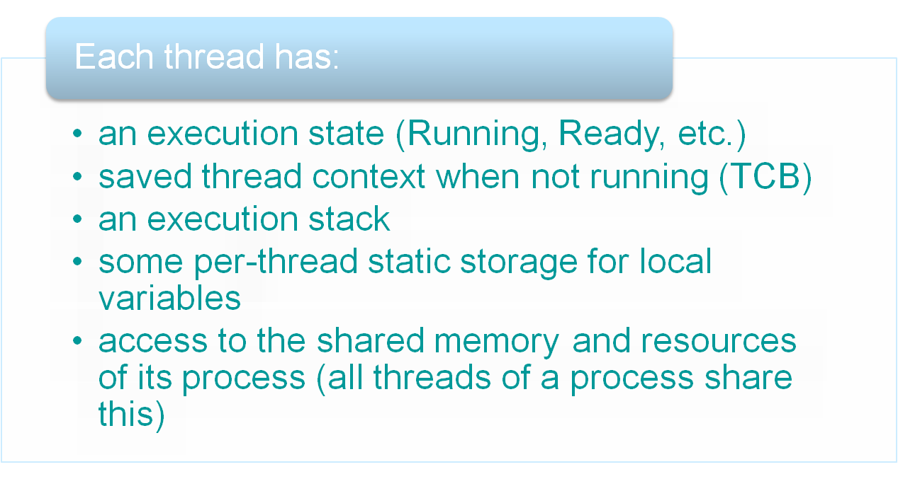
One or More Threads in a Process
Notes:
Within a process, there may be one or more threads, each with the following:
• A thread execution state (Running, Ready, etc.)
• A saved thread context when not running; one way to view a thread is as an independent program counter operating within a process
• An execution stack
• Some per-thread static storage for local variables
• Access to the memory and resources of its process, shared with all other threads in that process

Slide 21
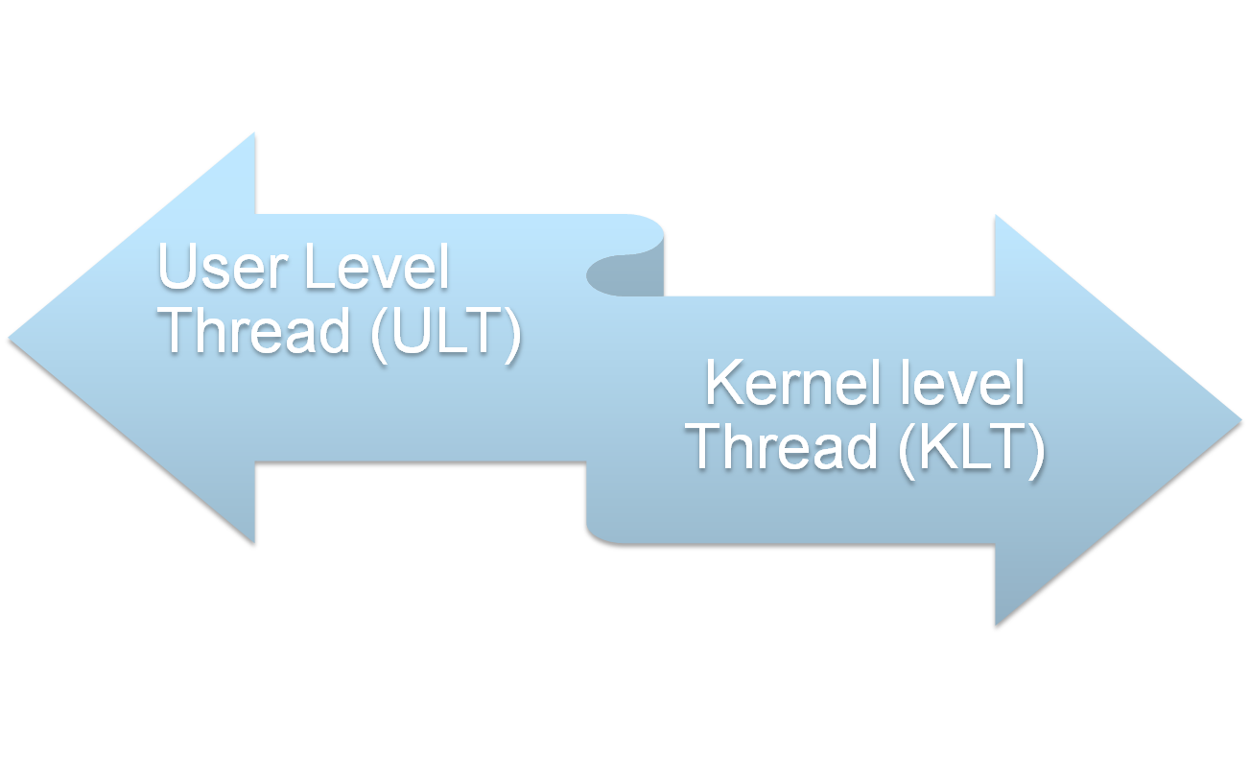

Types of Threads
NOTE: we are talking about threads for user processes. Both ULT & KLT execute in user mode. An OS may also have threads but that is not what we are discussing here.
Notes:
User-Level and Kernel-Level Threads
There are two broad categories of thread implementation: user-level threads (ULTs) and kernel-level threads (KLTs). The latter are also referred to in the literature as kernel-supported threads or lightweight processes.

Slide 22
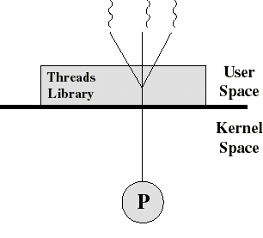
User-Level Threads (ULT)
The kernel is not aware of the existence of threads
All thread management is done by the application by using a thread library
Thread switching does not require kernel mode privileges (no mode switch)
Scheduling is application specific

Slide 23
Threads library
Contains code for:
  creating and destroying threads
  passing messages and data between threads
  scheduling thread execution
  saving and restoring thread contexts

Slide 24
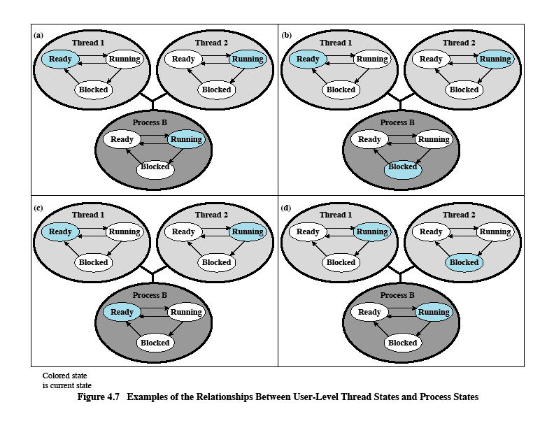
Relationships Between ULT
States and Process States
Possible transitions from a:
a→b
a→c
a→d
Examples of the Relationships between User-Level Thread States and Process States
Notes:
All of the activity described in the preceding paragraph takes place in user space and within a single process. The kernel is unaware of this activity. The kernel continues to schedule the process as a unit and assigns a single execution state (Ready, Running, Blocked, etc.) to that process. The following examples should clarify the relationship between thread scheduling and process scheduling. Suppose that process B is executing in its thread 2; the states of the process and two ULTs that are part of the process are shown in Figure 4.6a . Each of the following is a possible occurrence:
1. The application executing in thread 2 makes a system call that blocks B. For
example, an I/O call is made. This causes control to transfer to the kernel. The kernel invokes the I/O action, places process B in the Blocked state, and switches to another process. Meanwhile, according to the data structure maintained by the threads library, thread 2 of process B is still in the Running state. It is important to note that thread 2 is not actually running in the sense of being executed on a processor; but it is perceived as being in the Running state by the threads library. The corresponding state diagrams are shown in Figure 4.6b .
2. A clock interrupt passes control to the kernel and the kernel determines
that the currently running process (B) has exhausted its time slice. The kernel places process B in the Ready state and switches to another process. Meanwhile, according to the data structure maintained by the threads library, thread 2 of process B is still in the Running state. The corresponding state diagrams are shown in Figure 4.6c .
3. Thread 2 has reached a point where it needs some action performed by thread
1 of process B. Thread 2 enters a Blocked state and thread 1 transitions from Ready to Running. The process itself remains in the Running state. The corresponding state diagrams are shown in Figure 4.6d .
In cases 1 and 2 ( Figures 4.6b and 4.6c ), when the kernel switches control back to process B, execution resumes in thread 2. Also note that a process can be interrupted, either by exhausting its time slice or by being preempted by a higher priority process, while it is executing code in the threads library. Thus, a process may be in the midst of a thread switch from one thread to another when interrupted. When that process is resumed, execution continues within the threads library, which completes the thread switch and transfers control to another thread within that process.

Slide 25
Kernel activity for ULTs
The kernel is not aware of thread activity but it is still managing process activity
When a thread makes a system call, the whole process will be blocked
but for the thread library that thread is still in the running state
So thread states are independent of process states

Slide 26
Advantages and inconveniences of ULT
Advantages
  Thread switching does not involve the kernel: no mode switching
  Scheduling can be application specific: choose the best algorithm.
  ULTs can run on any OS. Only needs a thread library
Inconveniences
  Most system calls are blocking and the kernel blocks processes. So all threads within the process will be blocked
  The kernel can only assign processes to processors. Two threads within the same process cannot run simultaneously on two processors

Slide 27
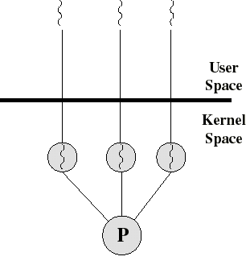
Kernel-Level Threads (KLT)
All thread management is done by kernel
No thread library but an API to the kernel thread facility
Kernel maintains context information for the process and the threads
Switching between threads requires the kernel
Scheduling on a thread basis
Ex: Windows NT and OS/2

Slide 28
Advantages and inconveniences of KLT
Advantages
  the kernel can simultaneously schedule many threads of the same process on many processors
  blocking is done on a thread level. If one thread in a process is blocked, the kernel can schedule another thread of the same process
  kernel routines can be multithreaded
Inconveniences
  thread switching within the same process involves the kernel. We have 2 mode switches per thread switch
  this results in a significant slow down

Slide 29
Multithreading Models
Many to many relationship.
Many to one relationship.
One to one relationship.

Slide 30
Multithreading Models(Many to Many)
Process P1 Process P2
User Space
Thread Library
Thread Library
Kernel Space
CPU
CPU
CPU
CPU

Slide 31
Multithreading Models(Many to One)
Process P1 Process P2
User Space
Thread Library
Thread Library
Kernel Space
CPU
CPU
CPU
CPU

Slide 32
Multithreading Models(one to one)
Process P1 Process P2
User Space
Thread Library
Thread Library
Kernel Space
CPU
CPU
CPU
CPU

Slide 33
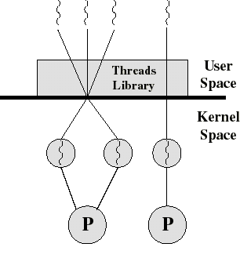
Combined ULT/KLT Approaches
Thread creation done in the user space
Bulk of scheduling and synchronization of threads done in the user space
The programmer may adjust the number of KLTs
May combine the best of both approaches
Example is Solaris

Slide 34
Difference between ULT & KLT
ULT
  ULTs are faster to create and manage.
  Implementation is by a thread library at the user level.
  User level thread is generic and can run on any operating system.
  Multithreaded applications can not take advantage of multiprocessing.
KLT
KLTs are slower to create and manage.
OS supports creation of kernel threads.
Kernel level thread is specific to the operating system.
Kernel routines themselves can be multithreaded.

Slide 35
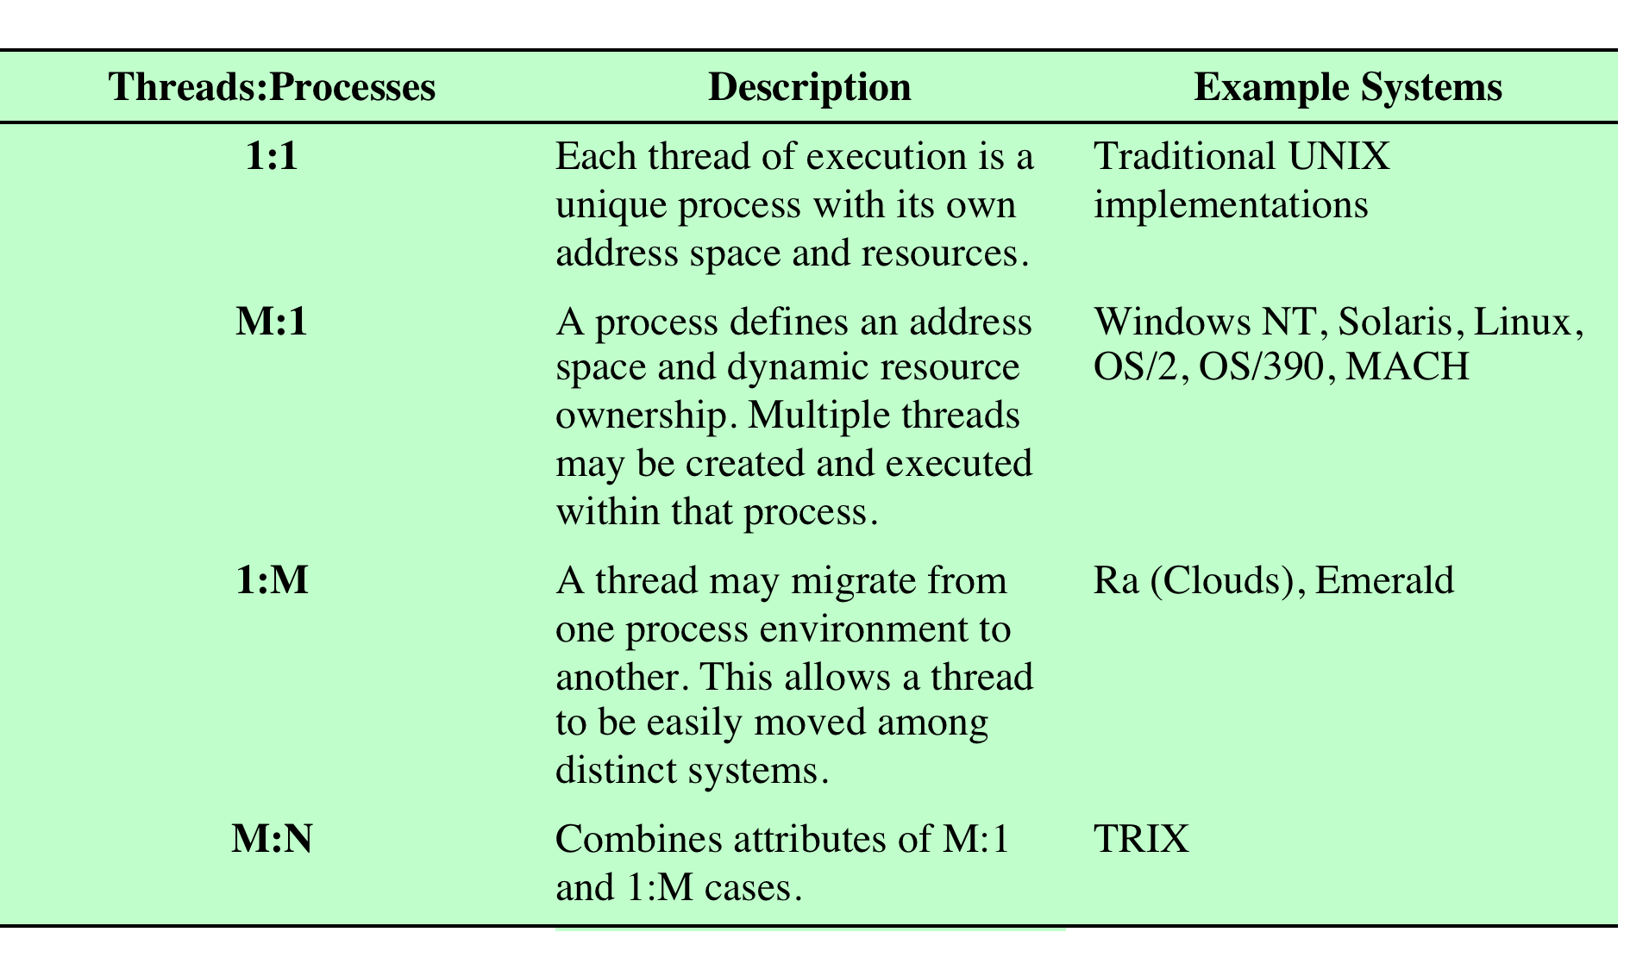
Relationship Between
Threads and Processes
Relationship between Threads and Processes
Notes:
As we have said, the concepts of resource allocation and dispatching unit have traditionally been embodied in the single concept of the process—that is, as a 1 : 1
relationship between threads and processes. Recently, there has been much interest in providing for multiple threads within a single process, which is a many-toone
relationship. However, as Table 4.2 shows, the other two combinations have also been investigated, namely, a many-to-many relationship and a one-to-many relationship.
The idea of having a many-to-many relationship between threads and processes has been explored in the experimental operating system TRIX [PAZZ92, WARD80]. In TRIX, there are the concepts of domain and thread. A domain is a static entity, consisting of an address space and “ports” through which messages may be sent and received. A thread is a single execution path, with an execution stack, processor state, and scheduling information.
As with the multithreading approaches discussed so far, multiple threads may execute in a single domain, providing the efficiency gains discussed earlier. However, it is also possible for a single user activity, or application, to be performed in multiple domains. In this case, a thread exists that can move from one domain to another.

Slide 36
Various Implementations
THREADS
PThreads
A POSIX standard (IEEE 1003.1c) API for thread creation and synchronization
API specifies behavior of the thread library, implementation is up to development of the library
Common in UNIX operating systems (Solaris, Linux, Mac OS X)
Windows Threads
Implements the one-to-one mapping
Each thread contains
  A thread id
  Register set
  Separate user and kernel stacks
  Private data storage area
The register set, stacks, and private storage area are known as the context of the threads
4: Threads

Slide 37

Various Implementations
THREADS
Linux Threads
Linux refers to them as tasks rather than threads
Thread creation is done through clone() system call
clone() allows a child task to share the address space of the parent task (process)
Java Threads
Java threads may be created by:
  Extending Thread class
  Implementing the Runnable interface
Java threads are managed by the JVM.
4: Threads

Slide 38
Solaris
Process includes the user’s address space, stack, and process control block
User-level threads (threads library)
  invisible to the OS
  are the interface for application parallelism
Kernel threads
  the unit that can be dispatched on a processor and it’s structures are maintain by the kernel
Lightweight processes (LWP)
  each LWP supports one or more ULTs and maps to exactly one KLT
  each LWP is visible to the application

Slide 39
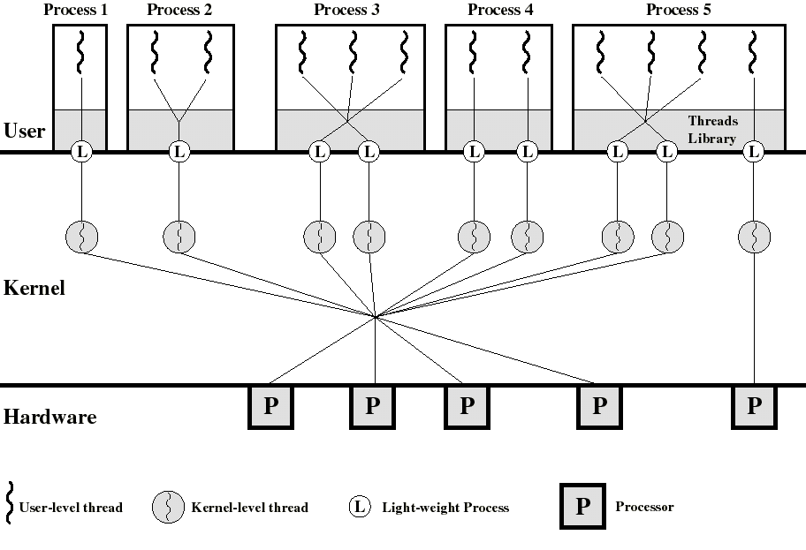
Process 2 is equivalent to a pure ULT approach
Process 4 is equivalent to a pure KLT approach
We can specify a different degree of parallelism (process 3 and 5)

Slide 40
Solaris: versatility
We can use ULTs when logical parallelism does not need to be supported by hardware parallelism (we save mode switching)
  Ex: Multiple windows but only one is active at any one time
If threads may block then we can specify two or more LWPs to avoid blocking the whole application

Slide 41
Solaris: user-level thread execution
Transitions among these states is under the exclusive control of the application
  a transition can occur only when a call is made to a function of the thread library
It’s only when a ULT is in the active state that it is attached to a LWP (so that it will run when the kernel level thread runs)
  a thread may transfer to the sleeping state by invoking a synchronization primitive (chap 5) and later transfer to the runnable state when the event waited for occurs
  A thread may force another thread to go to the stop state...

Slide 42
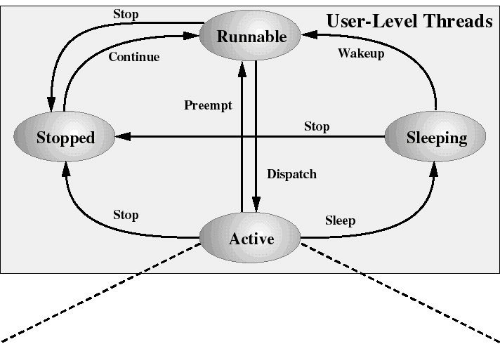
Solaris: user-level thread states
(attached to a LWP)

Slide 43
Decomposition of user-level Active state
When a ULT is Active, it is associated to a LWP and, thus, to a KLT
Transitions among the LWP states is under the exclusive control of the kernel
A LWP can be in the following states:
  running: when the KLT is executing
  blocked: because the KLT issued a blocking system call (but the ULT remains bound to that LWP and remains active)
  runnable: waiting to be dispatched to CPU

Slide 44
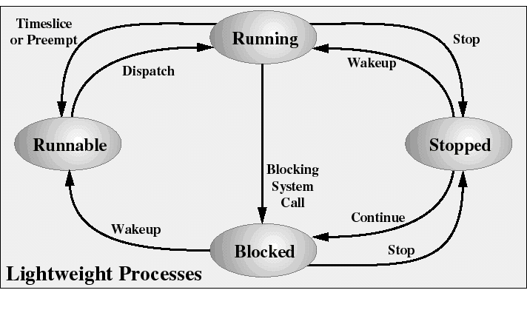
Solaris: Lightweight Process States
LWP states are independent of ULT states
(except for bound ULTs)

